Slide 1
A companion robot for employees in a company to increase productivity by reducing their stress level
AS2016502
K. G. S. Sandaruwan
01/07

Slide 2
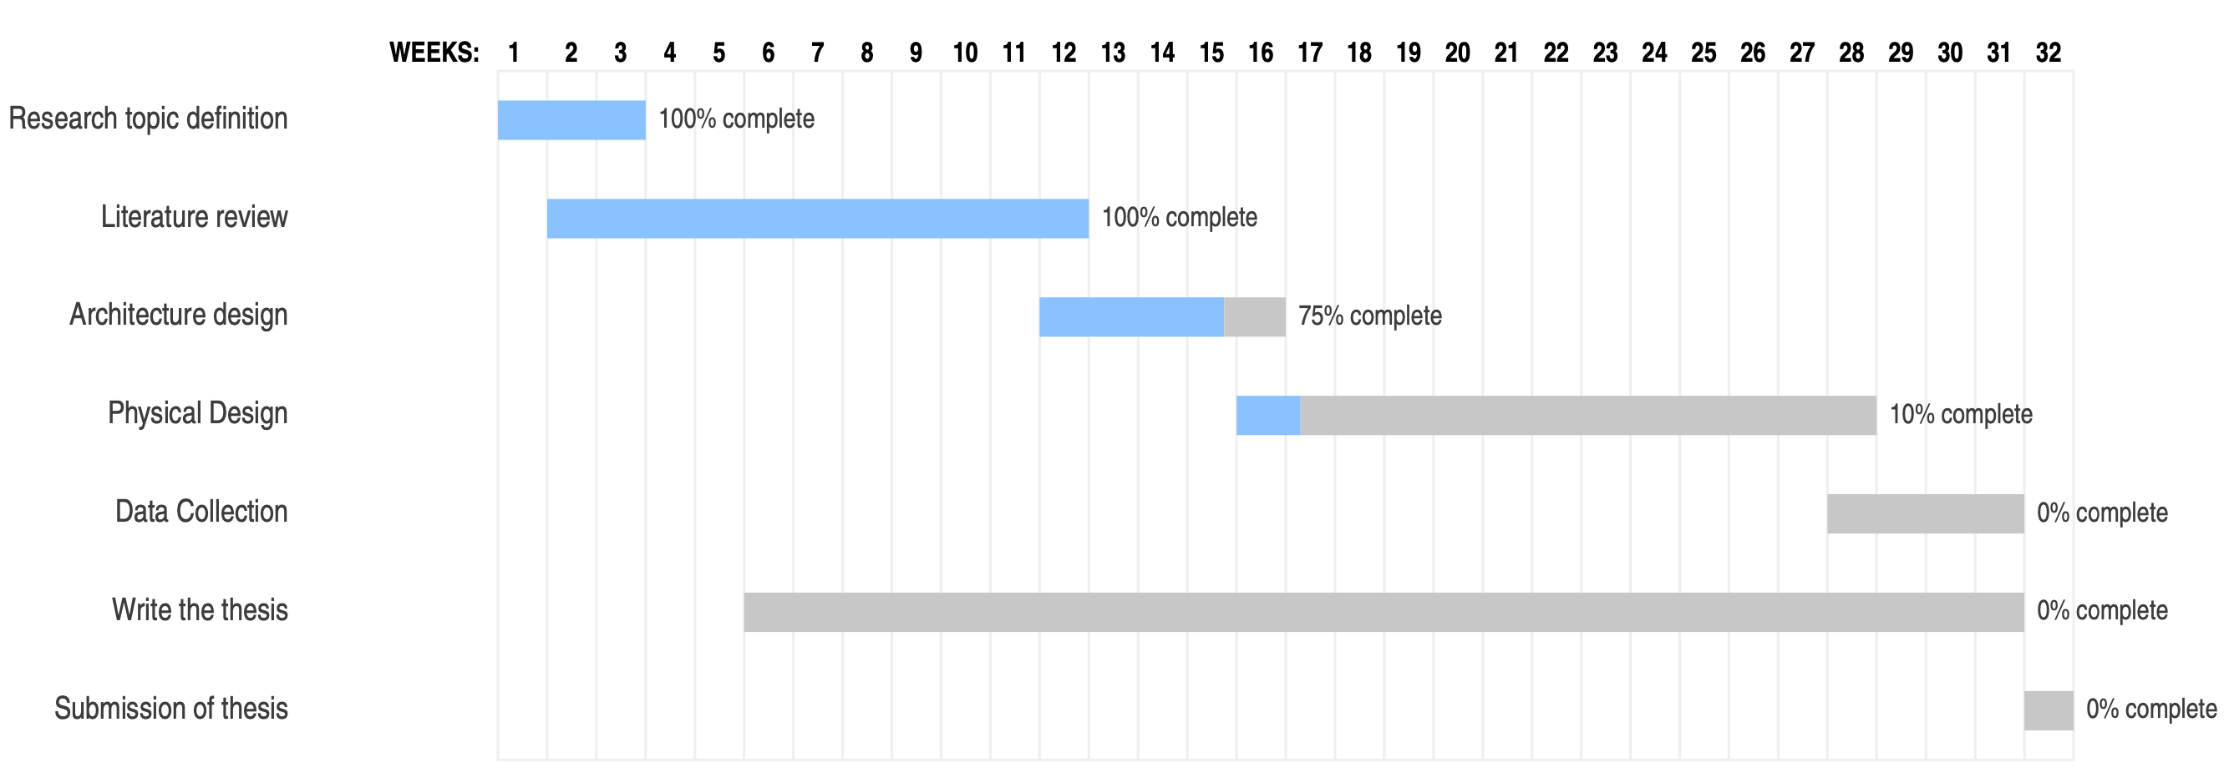
Current state
02/07

Slide 3
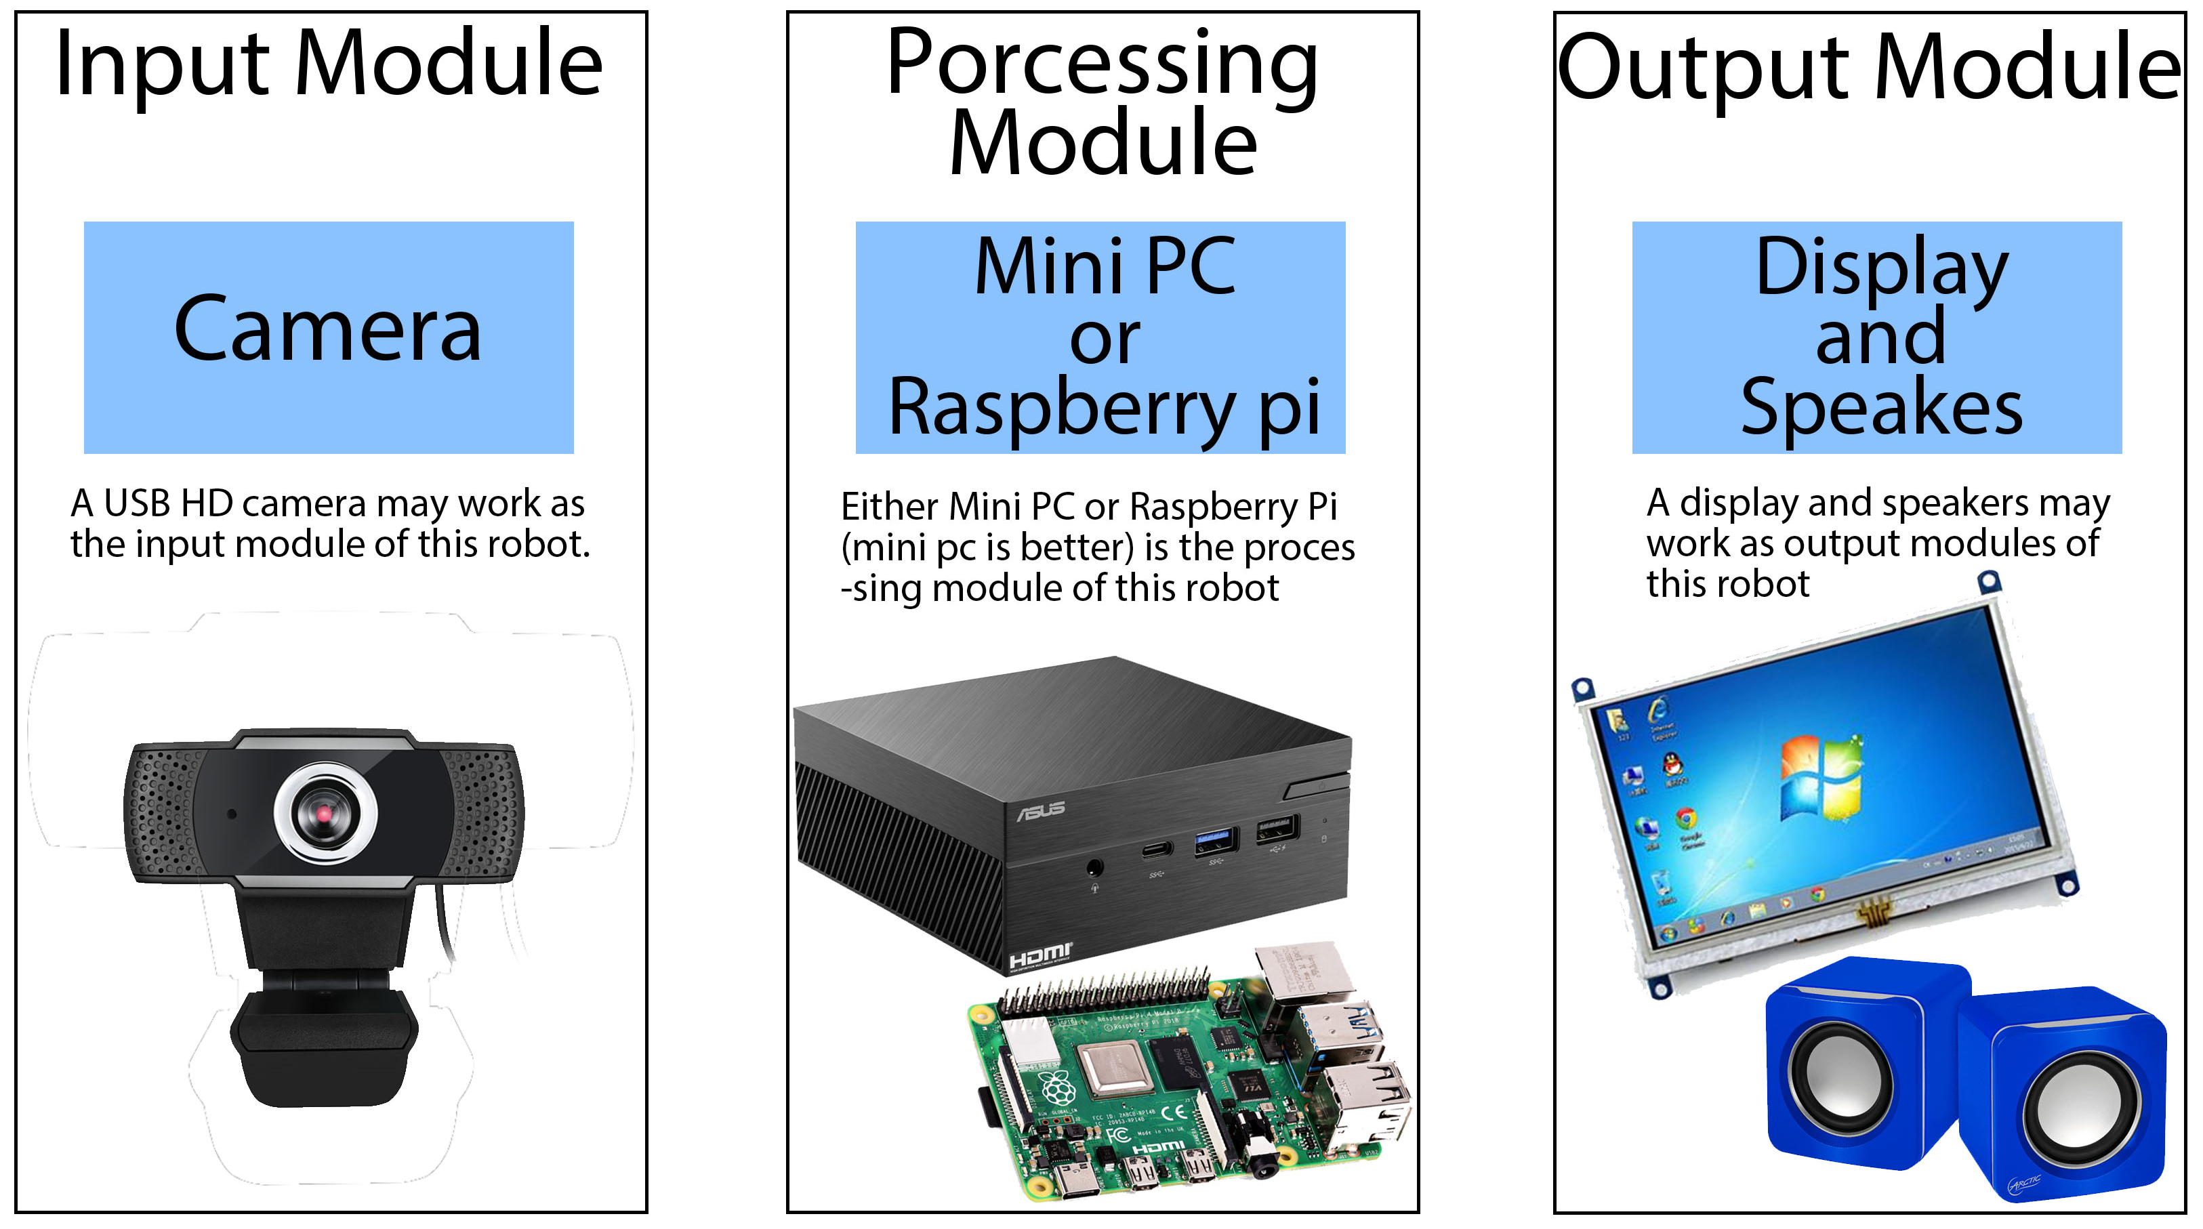
Architecture design
03/07

Slide 4
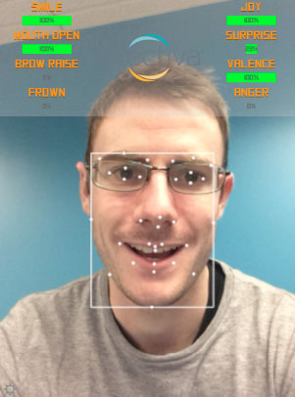
Decided technologies
Affdex SDK (from affective) for emotion tracking
Affdex is a C# SDK that can measure some parameters of emotional state real-time using a camera input
Working on setup it on my laptop first
Then check whether is there a direct measurement of boredom. If so, I can use it directly. Otherwise have to train a ML model to predict boredom state using other parameters such as sadness
04/07

Slide 5
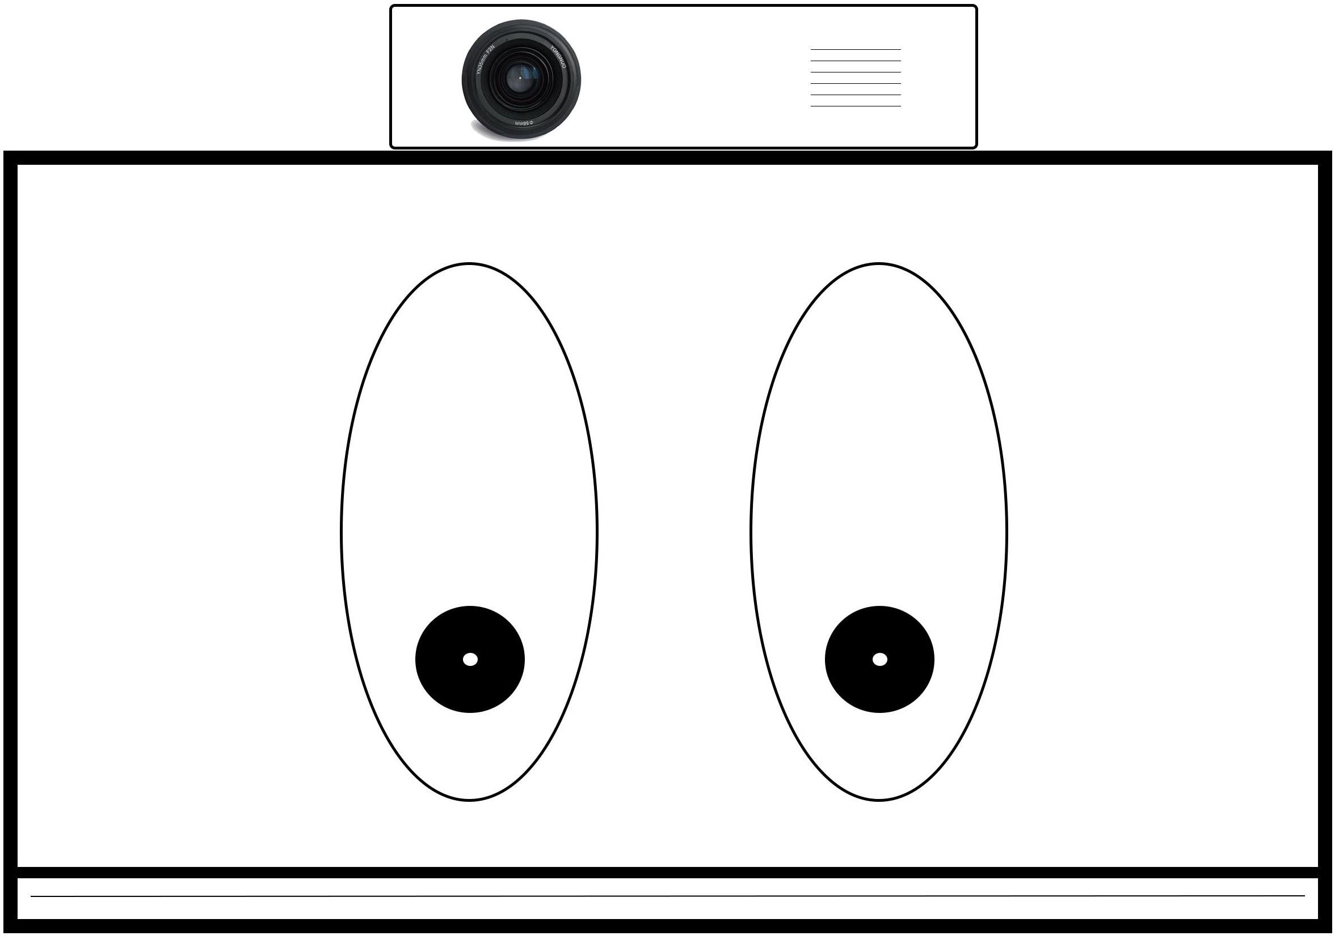
Physical Design
05/07

Slide 6
Next steps
Finalize architecture
Start developing software
Have to find the capabilities of affdex relates to my topic
Have to decide the final prediction generation algorithm
Start 3D designing of body
06/07

Slide 7

Thank you
07/07

